Slide 1
Lesson 5
Parametric test assumptions
& data transformations

Slide 2
Assumptions of a linear model
  Linear models make many assumptions, including:
  The model makes biological sense
  Additivity (terms are added together)
  Linearity
  Independence of errors
  Homoscedasticity – equal variance of errors
  Normality of errors.

Slide 3
Assumptions
Standard statistical tests are fairly robust, but major violation of assumptions means that the results of your analysis will be unreliable: the probability of making both Type I and Type II errors may be increased.
The effect of breaking assumptions is more serious when samples sizes are small or unbalanced.

Slide 4
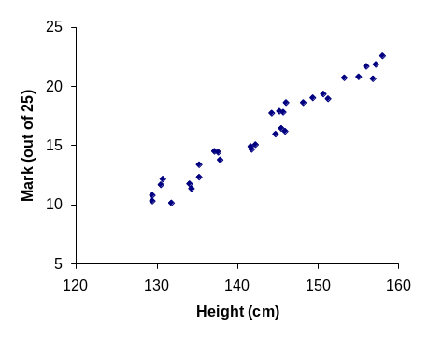
Linearity
Linear regression works by fitting a line through data. The best results are obtained when the relationship between variables is linear.
What can cause the assumption to be broken?
Intrinsically non-linear biological system (e.g. exponential growth)

Slide 5
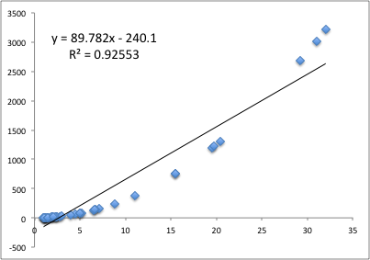
Linearity
If the relationship is not linear, then the fitted model will not fit the data properly across the domain of values

Slide 6
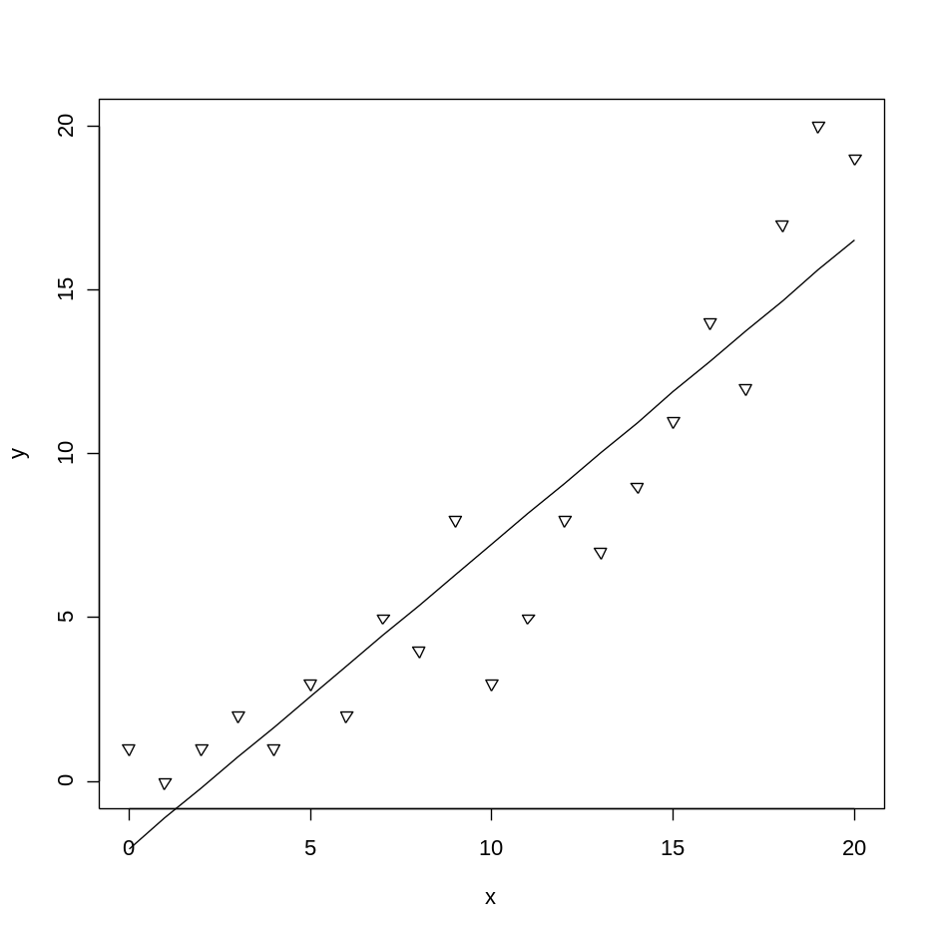
Linearity
Linearity:
How do we check it?
(1) Plot the raw data:
> plot(x,y)
> model<-lm(y~x)
> lines(x,model$fitted)

Slide 7
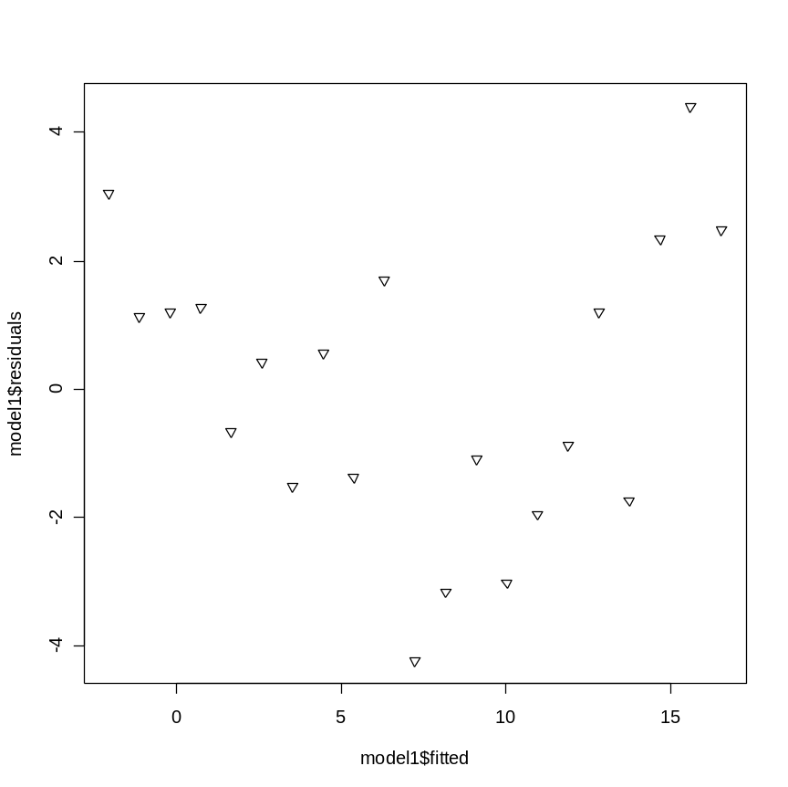
Linearity
Linearity:
How do we check it?
(2) Look for a trend in the model residuals:
>plot(model$fitted,model$residuals)

Slide 8

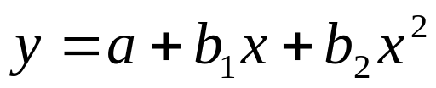
Linearity
What’s the solution?
Transform the response
Transform the predictor:
e.g. Polynomial regression

Slide 9
Distribution of residuals
The parametric tests are mathematically derived based on assumed distributions (e.g. normal, F)
Which means the tests can only be trusted when the data being tested follow the assumed distributions
e.g. t-tests assume residuals are approximately normally distributed

Slide 10
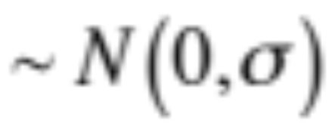
Normality
.. the residuals of the model should be normally distributed
Frequency
0
Residuals

Slide 11
Normality
What happens when we break it?
Parametric models are reasonably robust to this assumption, but in extreme cases can give unreliable parameter estimates and tests of significance (underestimate P value).
More unreliable for small sample sizes (N < 30)

Slide 12
Normality
How do we check it?
Use a normal probability plot – data points should lie in a straight diagonal line:

Slide 13
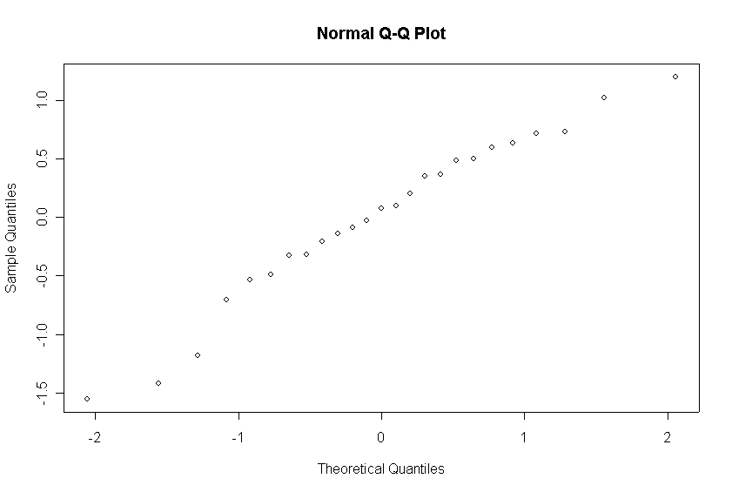
Distribution of residuals
Normal distribution of error term/model residuals:
Note: becomes difficult to interpret if <25 data points
> qqnorm(model.output$residuals)

Slide 14
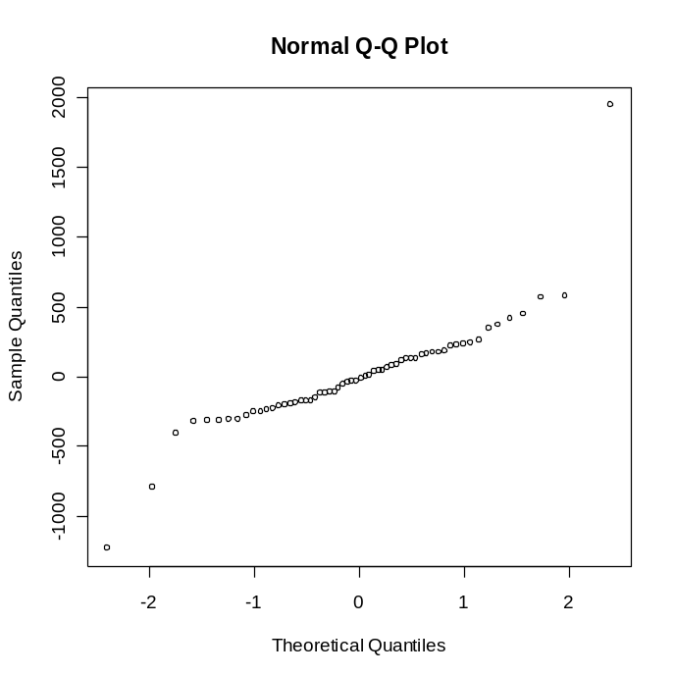
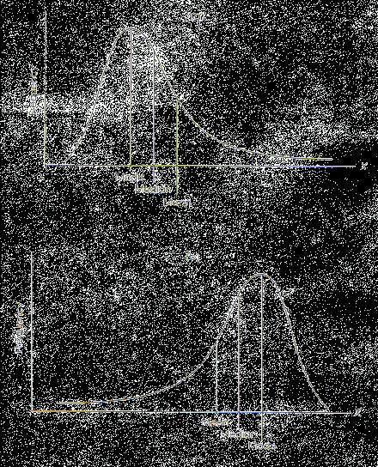
Distribution of residuals
Most common problem is positive skew:
Solution? Transform response variable
P
ositive

Slide 15
Homoscedasticity
Homogeneity of variances (Homoscedasticity):
i.e. the residuals (e_{i}’s) should have the same variance across values of the response variable
  Equal across all levels of the factor (ANOVA)

Slide 16


Homoscedasticity
What happens when we break it?
Can give unreliable parameter estimates and tests of significance. More important than normality.
How do we check it?
1) Plot residuals ( ) against fitted values ( )

Slide 17
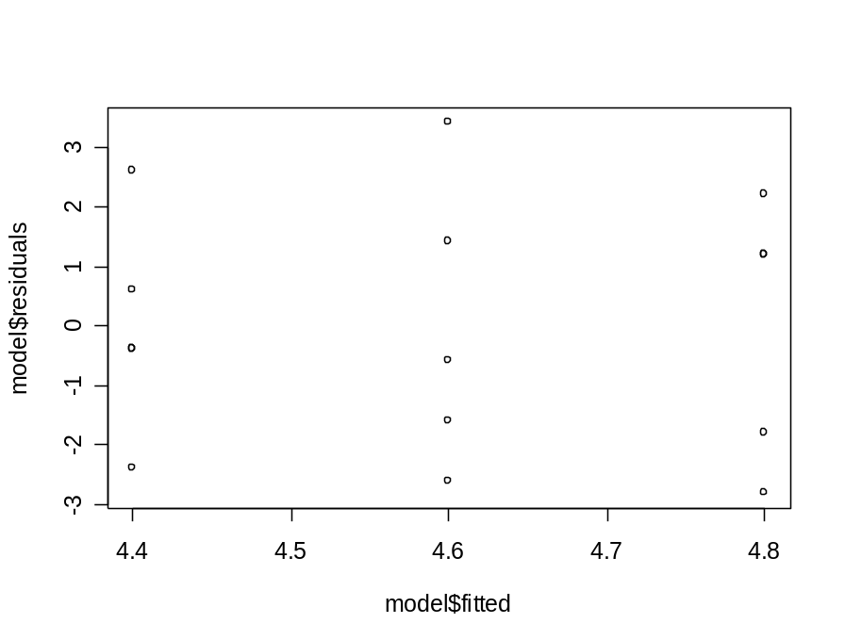
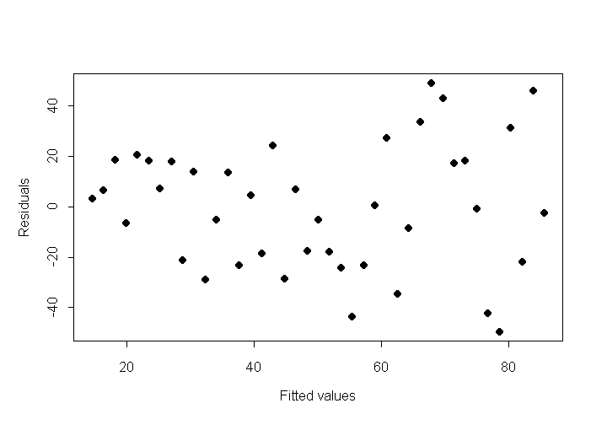
Homoscedasticity
> plot(model.output$fitted,model.output$residuals)
ANOVA | Regression

Slide 18
Homoscedasticity
What can cause the assumption to be broken?
Skew (response requires transformation)
Outliers
What’s the solution?
Transform the response variable

Slide 19
Summary
Parametric tests (ANOVA, regression, t-tests) make assumptions about the underlying distribution of the sampled populations
Major violation of assumptions means that the results of your analysis will be unreliable: the probability of making both Type I and Type II errors may be increased.

Slide 20
Summary
CHECKING THAT ASSUMPTIONS ARE SATISFIED IS A CRITICAL PART OF THE ANALYSIS PROCEDURE

Slide 21
Method for analysis
Plot histograms of data variables
Run first analysis
Examine residuals for normality, homogeneous variances and linearity
If problems, then try applying a transformation
Re-run analysis and then Re-check residuals

Slide 22
Exercise 5.1

Slide 23
Transformations

Slide 24
Biological Reasons For Data Transformation
Biological systems (at any scale) often grow non-linearly and are therefore intrinsically likely to break assumptions…
Positive feedback gives exponential behaviour e.g. unlimited population growth

Slide 25
Aims of Transformation
Transformation is usually performed to “correct” underlying distributions of the data
Common aims are to:
  make the data (specifically the model error terms) closer to a normal distribution
  reduce any relationship between the mean (fitted values) and the variance (i.e. reduce heteroscedasticity)
  improve linearity in regression analyses
  make multiplicative effects additive
Transformations are applied to the whole dataset of the variable and result in different scale of measurement

Slide 26
Aims of Transformation
Transformations are usually applied to response variables (y),
But they may also be applied to predictor variables, if these are non-normally distributed
The point is to linearise the data so that the regression can be performed most efficiently

Slide 27
Common transformations
Logarithmic
Square root
Power

Slide 28
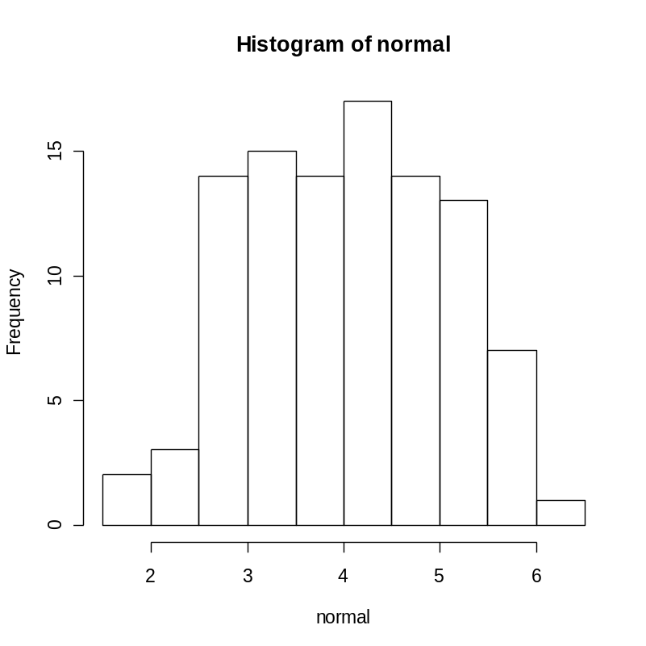
Checking data normality
-> usually the easiest way to see if a variable is non-normal is to check a histogram of the data

Slide 29
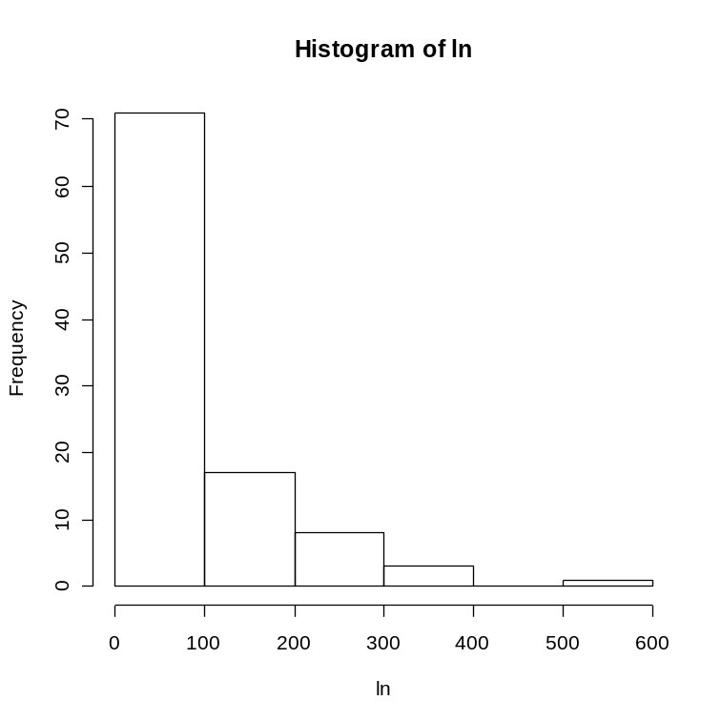
Log transformation:
Exponentially distributed data
Raw data, y
Transformed data, y^{T}
ln(y)

Slide 30
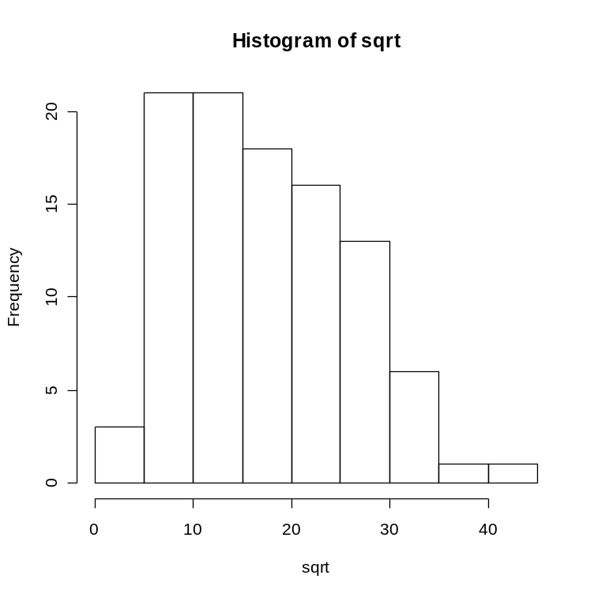
Square root transform: slightly negatively skewed data

Slide 31
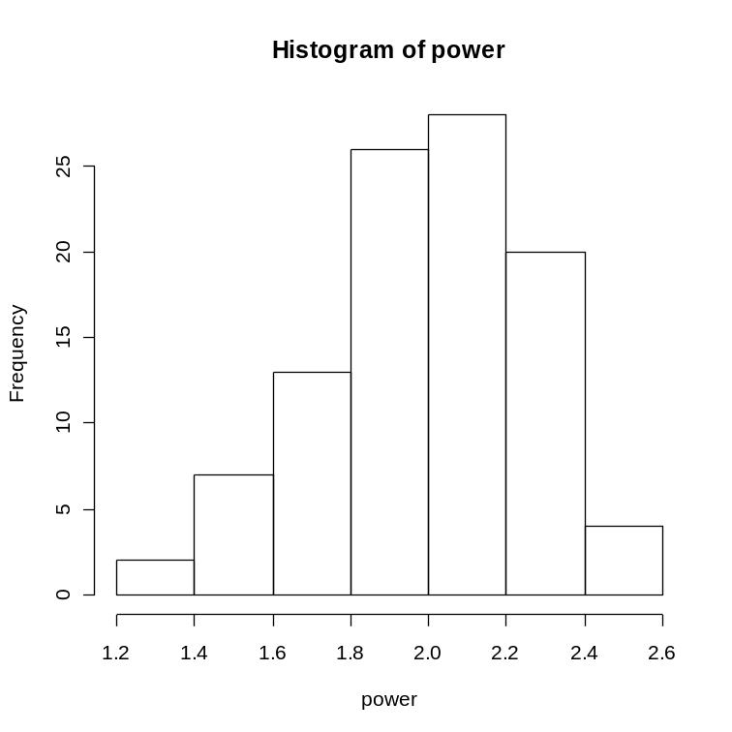
Power

Slide 32
Interpretation of results
A transformation is really changing your response variable and therefore your formal null hypothesis. Therefore both model and test must always be interpreted in terms of the transformed form of the data
e.g. if response has been log-transformed for regression:
Hypotheses:
H₀: The is no relationship between X and log(Y)
H_{A}: There is a relationship between X and log(Y)

Slide 33
Interpretation of results
Model:
log(y) = a + b.x or y = 10^{(a + b.x)}
Note: the model is linear, but the regression is non-linear when plotted on the original scale
Note: confidence intervals will be asymmetric when converted back to the original scale

Slide 34
Exercise 5.2. Leaf traits & Altitude
  Students are interested in understanding how future rises in temperature due to climate change may affect leaf functional traits in woody plants. It is difficult to study these effects in real time, so the students use an altitudinal gradient along a valley side to study the effects of altitude as a proxy for temperature change, taking 8 transects at different elevations. In these transects they identify all common tree species and measure leaf area and thickness on each of these species.
  Please would you help them assess how leaf thickness changes with altitude. For now, please ignore the effect of species.
Plot leaf thickness against Elevation.
Model leaf thickness as a function of Elevation
Plot residual diagnostics
Check the distribution of leaf thickness and transform if necessary
Model transformed leaf thickness as a function of elevation
Plot residual diagnostics
Write out the back-transformed model

Slide 35
End of Lecture 5

